Slide 1
Notes:
original slide show from: https://github.com/rstudio-education/master-the-tidyverse-instructors/tree/master/powerpoints

Slide 2
Open 03-Tidy-Data.Rmd

Slide 3
"Data are not just numbers,
they are numbers with a context."
- George Cobb and David Moore (1997)

Slide 4
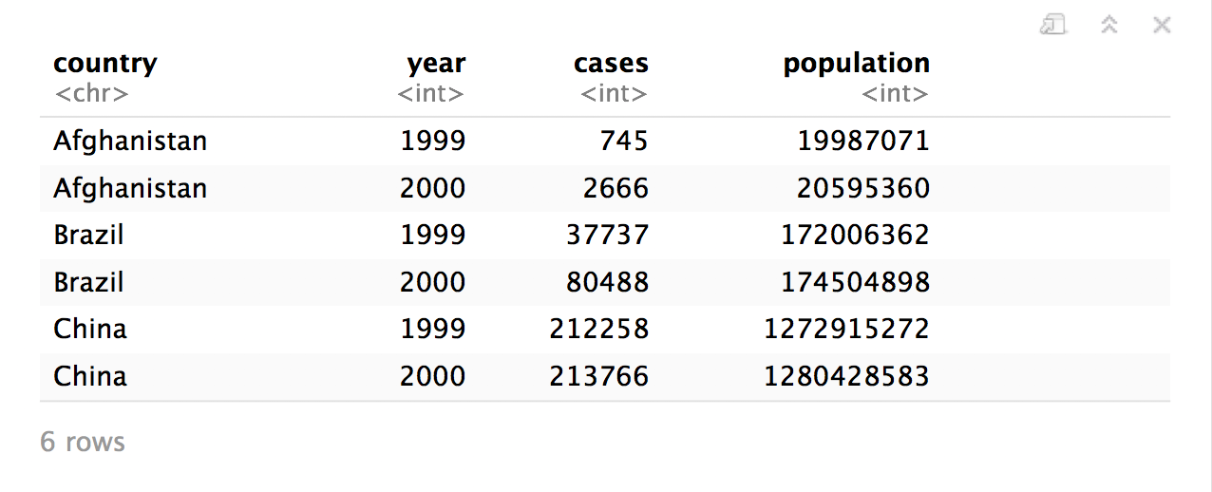
Quiz
What are the variables in this data set?
table1

Slide 5
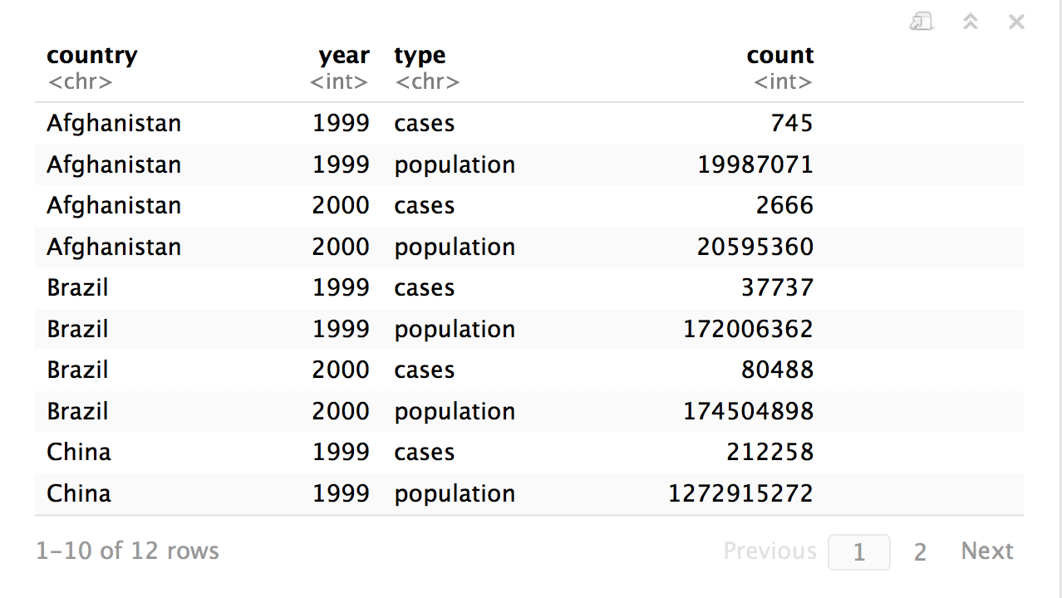
Quiz
What are the variables in this data set?
table2

Slide 6
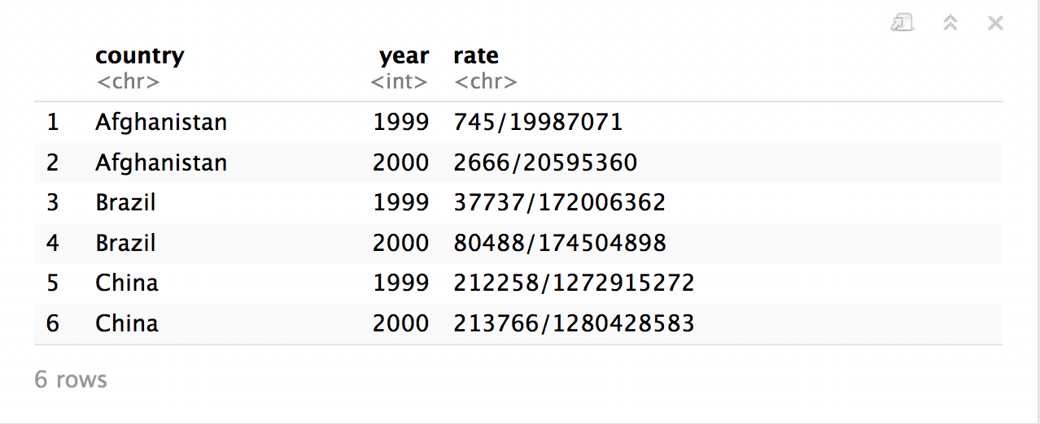

table3
CC BY-SA RStudio

Slide 7
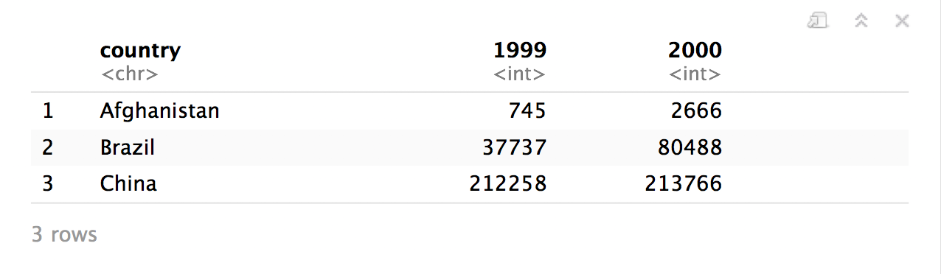
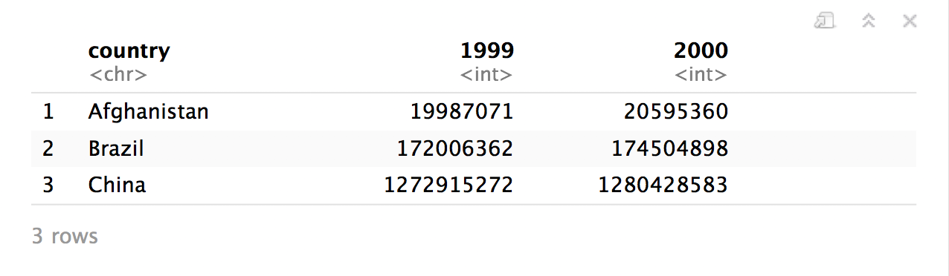
table4a
table4b
CC BY-SA RStudio

Slide 8
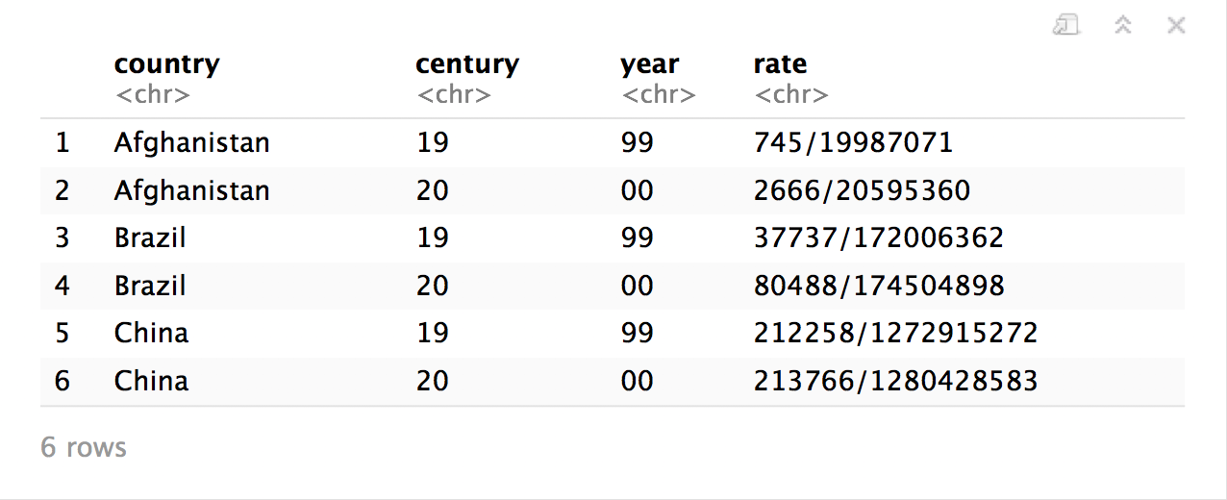
table5
CC BY-SA RStudio

Slide 9
"Data comes in many formats, but R prefers just one: tidy data. "
- Garrett Grolemund

Slide 10
Tidy data
country | year | cases | pop
Afghanistan | 1999 | 745 | 19987071
Afghanistan | 2000 | 2666 | 20595360
Brazil | 1999 | 37737 | 172006362
Brazil | 2000 | 80488 | 174504898
China | 1999 | 212258 | 1272915272
China | 2000 | 213766 | 1280428583
A data set is tidy iff:
Each variable is in its own column
Each case is in its own row
Each value is in its own cell

Slide 11
table1$country
table1$year
table1$cases
table1$population

Slide 12


table2$country
table2$year
table2$count[c(1,3,5,7,9,11)]
table2$count[c(2,4,6,8,10,12)]

Slide 13
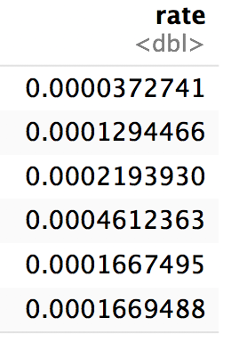
table1$cases / table1$population -> table1$rate

Slide 14
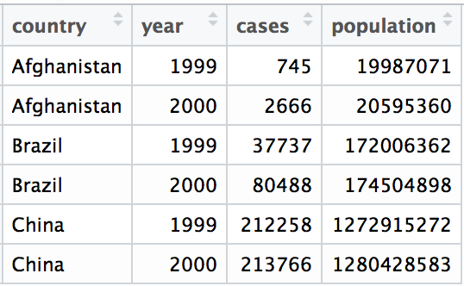
Tidy data
A data set is tidy iff:
Each variable is in its own column
Each case is in its own row
Each value is in its own cell

Slide 15
Import data into software
Collect
Data
Tidy data into useable form
Design Experiment
Explore or Test
Form Hypothesis
Transform the data. Do feature engineering.
Deploy app or publish paper
Write code to apply a modeling algorithm.
Build app or write paper
Visualize the data and/or results
Communicate Results

Slide 16
Tidy data into useable form
Import data into software
Munge data
Collect
Data
Explore or Test
Design Experiment
Transform the data. Do feature engineering.
Form Hypothesis
Munge data
Deploy app or publish paper
Write code to apply a modeling algorithm.
Build app or write paper
Munge data
Communicate Results
Visualize the data and/or results
Munge data

Slide 17
Tidy data
Tidy functions all expect and return the same data structure, known as tidy data:
A data frame that contains
variables in the columns and
cases in the rows.

Slide 18
"Tidy data sets are all alike; but every messy data set is messy in its own way."
- Hadley Wickham

Slide 19

tidyr

Slide 20
tidyr
A package that reshapes the layout of tabular data.
CC BY-SA RStudio

Slide 21
pivot_longer()

Slide 22
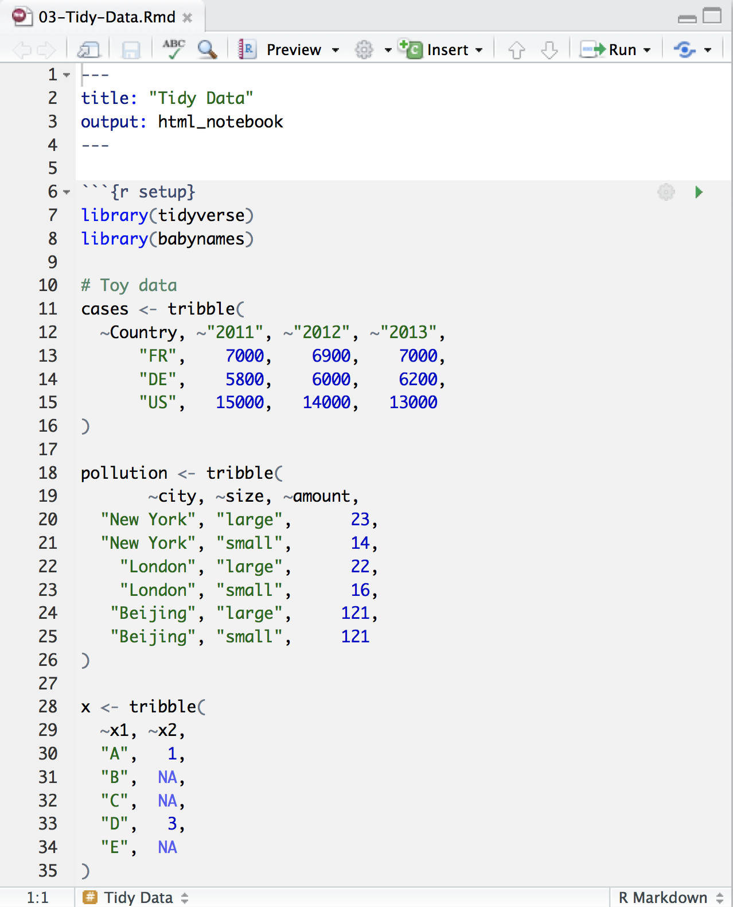
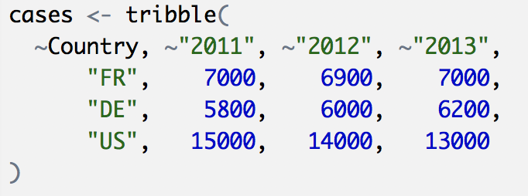
Toy data
CC BY-SA RStudio

Slide 23
Quiz
What are the variables in cases?
Country | 2011 | 2012 | 2013
FR | 7000 | 6900 | 7000
DE | 5800 | 6000 | 6200
US | 15000 | 14000 | 13000

Slide 24
Quiz
What are the variables in cases?
Country | 2011 | 2012 | 2013
FR | 7000 | 6900 | 7000
DE | 5800 | 6000 | 6200
US | 15000 | 14000 | 13000
Country
Year
Count

Slide 25
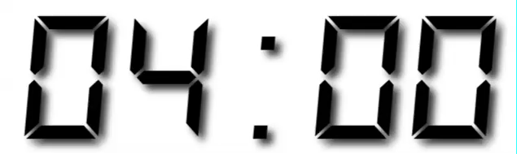
Your Turn 1
On a sheet of paper, draw how the cases data set would look if it had the same values grouped into three columns: country, year, n
Country | 2011 | 2012 | 2013
FR | 7000 | 6900 | 7000
DE | 5800 | 6000 | 6200
US | 15000 | 14000 | 13000

Slide 26
Country | 2011 | 2012 | 2013
FR | 7000 | 6900 | 7000
DE | 5800 | 6000 | 6200
US | 15000 | 14000 | 13000
CC BY-SA RStudio

Slide 27
Country | 2011 | 2012 | 2013
FR | 7000 | 6900 | 7000
DE | 5800 | 6000 | 6200
US | 15000 | 14000 | 13000
Country | Year | n
FR | 2011 | 7000
DE | 2011 | 5800
US | 2011 | 15000
FR | 2012 | 6900
DE | 2012 | 6000
US | 2012 | 14000
FR | 2013 | 7000
DE | 2013 | 6200
US | 2013 | 13000
CC BY-SA RStudio

Slide 28
Country | 2011 | 2012 | 2013
FR | 7000 | 6900 | 7000
DE | 5800 | 6000 | 6200
US | 15000 | 14000 | 13000
Country | Year | n
FR | 2011 | 7000
DE | 2011 | 5800
US | 2011 | 15000
FR | 2012 | 6900
DE | 2012 | 6000
US | 2012 | 14000
FR | 2013 | 7000
DE | 2013 | 6200
US | 2013 | 13000
CC BY-SA RStudio

Slide 29
Country | 2011 | 2012 | 2013
FR | 7000 | 6900 | 7000
DE | 5800 | 6000 | 6200
US | 15000 | 14000 | 13000
Country | Year | n
FR | 2011 | 7000
DE | 2011 | 5800
US | 2011 | 15000
FR | 2012 | 6900
DE | 2012 | 6000
US | 2012 | 14000
FR | 2013 | 7000
DE | 2013 | 6200
US | 2013 | 13000
CC BY-SA RStudio

Slide 30
Country | 2011 | 2012 | 2013
FR | 7000 | 6900 | 7000
DE | 5800 | 6000 | 6200
US | 15000 | 14000 | 13000
Country | Year | n
FR | 2011 | 7000
DE | 2011 | 5800
US | 2011 | 15000
FR | 2012 | 6900
DE | 2012 | 6000
US | 2012 | 14000
FR | 2013 | 7000
DE | 2013 | 6200
US | 2013 | 13000
CC BY-SA RStudio

Slide 31
Country | 2011 | 2012 | 2013
FR | 7000 | 6900 | 7000
DE | 5800 | 6000 | 6200
US | 15000 | 14000 | 13000
Country | Year | n
FR | 2011 | 7000
DE | 2011 | 5800
US | 2011 | 15000
FR | 2012 | 6900
DE | 2012 | 6000
US | 2012 | 14000
FR | 2013 | 7000
DE | 2013 | 6200
US | 2013 | 13000
CC BY-SA RStudio

Slide 32
Country | 2011 | 2012 | 2013
FR | 7000 | 6900 | 7000
DE | 5800 | 6000 | 6200
US | 15000 | 14000 | 13000
Country | Year | n
FR | 2011 | 7000
DE | 2011 | 5800
US | 2011 | 15000
FR | 2012 | 6900
DE | 2012 | 6000
US | 2012 | 14000
FR | 2013 | 7000
DE | 2013 | 6200
US | 2013 | 13000
CC BY-SA RStudio

Slide 33
Country | 2011 | 2012 | 2013
FR | 7000 | 6900 | 7000
DE | 5800 | 6000 | 6200
US | 15000 | 14000 | 13000
Country | Year | n
FR | 2011 | 7000
DE | 2011 | 5800
US | 2011 | 15000
FR | 2012 | 6900
DE | 2012 | 6000
US | 2012 | 14000
FR | 2013 | 7000
DE | 2013 | 6200
US | 2013 | 13000
CC BY-SA RStudio

Slide 34
Country | 2011 | 2012 | 2013
FR | 7000 | 6900 | 7000
DE | 5800 | 6000 | 6200
US | 15000 | 14000 | 13000
Country | Year | n
FR | 2011 | 7000
DE | 2011 | 5800
US | 2011 | 15000
FR | 2012 | 6900
DE | 2012 | 6000
US | 2012 | 14000
FR | 2013 | 7000
DE | 2013 | 6200
US | 2013 | 13000
CC BY-SA RStudio

Slide 35
Country | 2011 | 2012 | 2013
FR | 7000 | 6900 | 7000
DE | 5800 | 6000 | 6200
US | 15000 | 14000 | 13000
Country | Year | n
FR | 2011 | 7000
DE | 2011 | 5800
US | 2011 | 15000
FR | 2012 | 6900
DE | 2012 | 6000
US | 2012 | 14000
FR | 2013 | 7000
DE | 2013 | 6200
US | 2013 | 13000
CC BY-SA RStudio

Slide 36
Country | 2011 | 2012 | 2013
FR | 7000 | 6900 | 7000
DE | 5800 | 6000 | 6200
US | 15000 | 14000 | 13000
Country | Year | n
FR | 2011 | 7000
DE | 2011 | 5800
US | 2011 | 15000
FR | 2012 | 6900
DE | 2012 | 6000
US | 2012 | 14000
FR | 2013 | 7000
DE | 2013 | 6200
US | 2013 | 13000
CC BY-SA RStudio

Slide 37
Country | 2011 | 2012 | 2013
FR | 7000 | 6900 | 7000
DE | 5800 | 6000 | 6200
US | 15000 | 14000 | 13000
Country | Year | n
FR | 2011 | 7000
DE | 2011 | 5800
US | 2011 | 15000
FR | 2012 | 6900
DE | 2012 | 6000
US | 2012 | 14000
FR | 2013 | 7000
DE | 2013 | 6200
US | 2013 | 13000
CC BY-SA RStudio

Slide 38
Country | 2011 | 2012 | 2013
FR | 7000 | 6900 | 7000
DE | 5800 | 6000 | 6200
US | 15000 | 14000 | 13000
Country | Year | n
FR | 2011 | 7000
DE | 2011 | 5800
US | 2011 | 15000
FR | 2012 | 6900
DE | 2012 | 6000
US | 2012 | 14000
FR | 2013 | 7000
DE | 2013 | 6200
US | 2013 | 13000
pivot_longer()
CC BY-SA RStudio

Slide 39
1
2
Country | 2011 | 2012 | 2013
FR | 7000 | 6900 | 7000
DE | 5800 | 6000 | 6200
US | 15000 | 14000 | 13000
Country | Year | n
FR | 2011 | 7000
DE | 2011 | 5800
US | 2011 | 15000
FR | 2012 | 6900
DE | 2012 | 6000
US | 2012 | 14000
FR | 2013 | 7000
DE | 2013 | 6200
US | 2013 | 13000
CC BY-SA RStudio

Slide 40
names_to (former column names)
Country | 2011 | 2012 | 2013
FR | 7000 | 6900 | 7000
DE | 5800 | 6000 | 6200
US | 15000 | 14000 | 13000
Country | Year | n
FR | 2011 | 7000
DE | 2011 | 5800
US | 2011 | 15000
FR | 2012 | 6900
DE | 2012 | 6000
US | 2012 | 14000
FR | 2013 | 7000
DE | 2013 | 6200
US | 2013 | 13000
CC BY-SA RStudio

Slide 41
values_to (former cells)
Country | 2011 | 2012 | 2013
FR | 7000 | 6900 | 7000
DE | 5800 | 6000 | 6200
US | 15000 | 14000 | 13000
Country | Year | n
FR | 2011 | 7000
DE | 2011 | 5800
US | 2011 | 15000
FR | 2012 | 6900
DE | 2012 | 6000
US | 2012 | 14000
FR | 2013 | 7000
DE | 2013 | 6200
US | 2013 | 13000
CC BY-SA RStudio

Slide 42
pivot_longer()
cases %>% pivot_longer(cols = 2:4, names_to = "year", values_to = "n")
data frame to reshape
numeric indexes of columns to collapse
(or names)
name of the new key column
(a character string)
name of the new value column
(a character string)

Slide 43
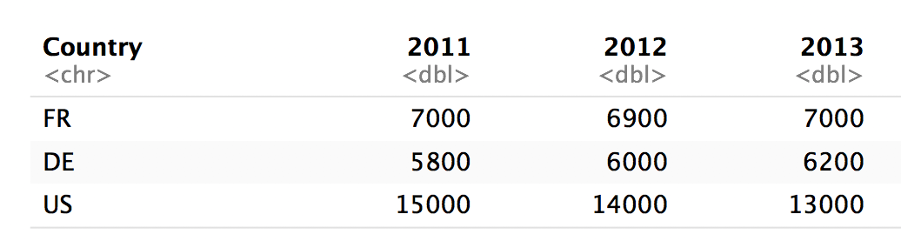
pivot_longer()
cases %>% pivot_longer(2:4, "year", "n")
numeric indexes
2
3
4

Slide 44
pivot_longer()
cases %>% pivot_longer(c("2011", "2012", "2013"), "year", "n")
names
2011
2012
2013

Slide 45
pivot_longer()
cases %>% pivot_longer(-Country, "year","n")
Everything except…
Not Country
Not Country
Not Country

Slide 46
pivot_longer()
cases %>% pivot_longer(2:4, "year", "n")
cases %>% pivot_longer(c("2011", "2012", "2013"), "year", "n")
cases %>% pivot_longer(starts_with("201"), "year", "n")
cases %>% pivot_longer(-Country, "year","n")

Slide 47
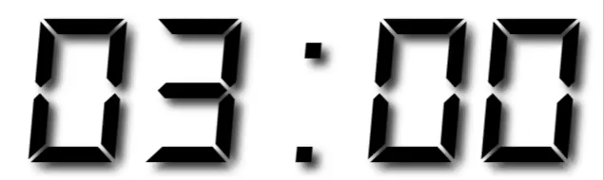
Your Turn 2
Use pivot_longer() to reorganize table4a into three columns: country, year, and cases.

Slide 48
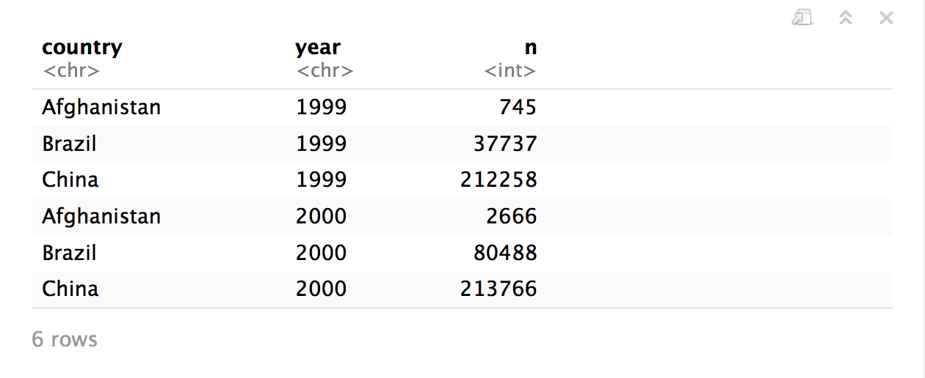
table4a %>%
pivot_longer(cols = 2:3, names_to = "year", values_to = "n")

Slide 49
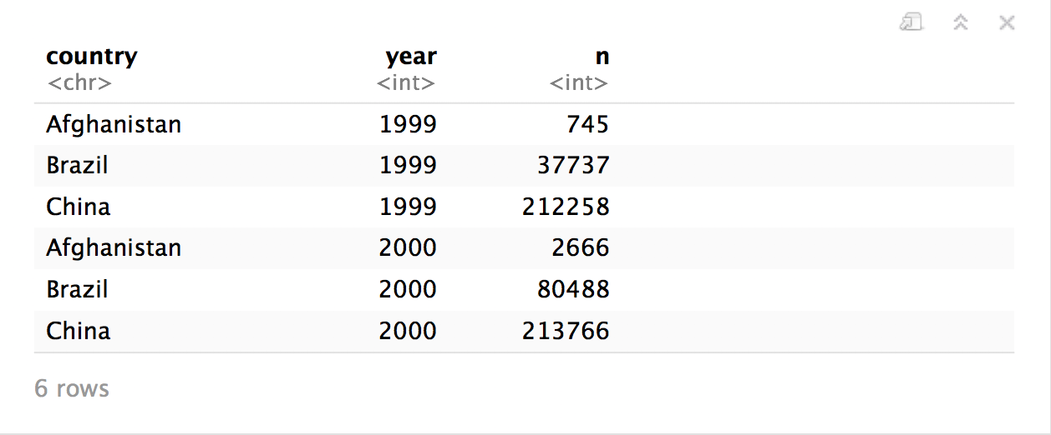
table4a %>%
pivot_longer(cols = 2:3, names_to = "year", values_to = "n",
names_ptypes = list(year = integer()))

Slide 50
pivot_wider()

Slide 51
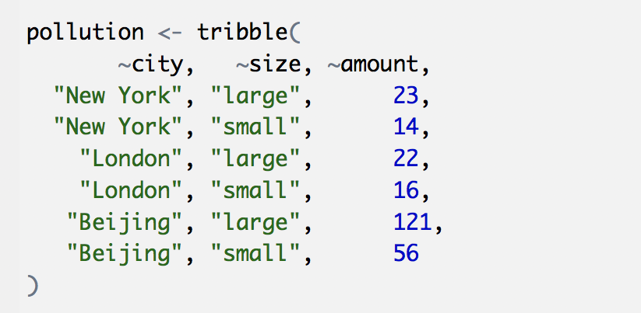
Toy data
CC BY-SA RStudio

Slide 52
Quiz
What are the variables in pollution?
city | particle size | amount (µg/m³)
New York | large | 23
New York | small | 14
London | large | 22
London | small | 16
Beijing | large | 121
Beijing | small | 56

Slide 53

Quiz
What are the variables in pollution?
city | particle size | amount (µg/m³)
New York | large | 23
New York | small | 14
London | large | 22
London | small | 16
Beijing | large | 121
Beijing | small | 56
City
Amount of large particulate
Amount of small particulate

Slide 54
Your Turn 3
On a sheet of paper, draw how this data set would look if it had the same values grouped into three columns: city, large, small
city | size | amount
New York | large | 23
New York | small | 14
London | large | 22
London | small | 16
Beijing | large | 121
Beijing | small | 56

Slide 55
city | size | amount
New York | large | 23
New York | small | 14
London | large | 22
London | small | 16
Beijing | large | 121
Beijing | small | 56
CC BY-SA RStudio

Slide 56
city | size | amount
New York | large | 23
New York | small | 14
London | large | 22
London | small | 16
Beijing | large | 121
Beijing | small | 56
city | large | small
New York | 23 | 14
London | 22 | 16
Beijing | 121 | 56
CC BY-SA RStudio

Slide 57
city | size | amount
New York | large | 23
New York | small | 14
London | large | 22
London | small | 16
Beijing | large | 121
Beijing | small | 56
city | large | small
New York | 23 | 14
London | 22 | 16
Beijing | 121 | 56
CC BY-SA RStudio

Slide 58
city | size | amount
New York | large | 23
New York | small | 14
London | large | 22
London | small | 16
Beijing | large | 121
Beijing | small | 56
city | large | small
New York | 23 | 14
London | 22 | 16
Beijing | 121 | 56
CC BY-SA RStudio

Slide 59
city | size | amount
New York | large | 23
New York | small | 14
London | large | 22
London | small | 16
Beijing | large | 121
Beijing | small | 56
city | large | small
New York | 23 | 14
London | 22 | 16
Beijing | 121 | 56
CC BY-SA RStudio

Slide 60
city | size | amount
New York | large | 23
New York | small | 14
London | large | 22
London | small | 16
Beijing | large | 121
Beijing | small | 56
city | large | small
New York | 23 | 14
London | 22 | 16
Beijing | 121 | 56
CC BY-SA RStudio

Slide 61
city | size | amount
New York | large | 23
New York | small | 14
London | large | 22
London | small | 16
Beijing | large | 121
Beijing | small | 56
city | large | small
New York | 23 | 14
London | 22 | 16
Beijing | 121 | 56
CC BY-SA RStudio

Slide 62
city | size | amount
New York | large | 23
New York | small | 14
London | large | 22
London | small | 16
Beijing | large | 121
Beijing | small | 56
city | large | small
New York | 23 | 14
London | 22 | 16
Beijing | 121 | 56
CC BY-SA RStudio

Slide 63
city | size | amount
New York | large | 23
New York | small | 14
London | large | 22
London | small | 16
Beijing | large | 121
Beijing | small | 56
city | large | small
New York | 23 | 14
London | 22 | 16
Beijing | 121 | 56
CC BY-SA RStudio

Slide 64
city | size | amount
New York | large | 23
New York | small | 14
London | large | 22
London | small | 16
Beijing | large | 121
Beijing | small | 56
pivot_wider()
city | large | small
New York | 23 | 14
London | 22 | 16
Beijing | 121 | 56
CC BY-SA RStudio

Slide 65
1
2
city | size | amount
New York | large | 23
New York | small | 14
London | large | 22
London | small | 16
Beijing | large | 121
Beijing | small | 56
city | large | small
New York | 23 | 14
London | 22 | 16
Beijing | 121 | 56
CC BY-SA RStudio

Slide 66
names_from (new column names)
city | size | amount
New York | large | 23
New York | small | 14
London | large | 22
London | small | 16
Beijing | large | 121
Beijing | small | 56
city | large | small
New York | 23 | 14
London | 22 | 16
Beijing | 121 | 56
CC BY-SA RStudio

Slide 67
values_from (new cells)
city | size | amount
New York | large | 23
New York | small | 14
London | large | 22
London | small | 16
Beijing | large | 121
Beijing | small | 56
city | large | small
New York | 23 | 14
London | 22 | 16
Beijing | 121 | 56
CC BY-SA RStudio

Slide 68
pivot_wider()
pollution %>% pivot_wider(names_from = size, values_from = amount)
data frame to reshape
column to use for keys (becomes new
column names)
column to use for values
(becomes new
column cells)

Slide 69
pollution %>% pivot_wider(names_from = size, values_from = amount)
city | size | amount
New York | large | 23
New York | small | 14
London | large | 22
London | small | 16
Beijing | large | 121
Beijing | small | 56
city | large | small
New York | 23 | 14
London | 22 | 16
Beijing | 121 | 56
CC BY-SA RStudio

Slide 70
Your Turn 4
Use pivot_wider() to reorganize table2 into four columns: country, year, cases, and population.

Slide 71
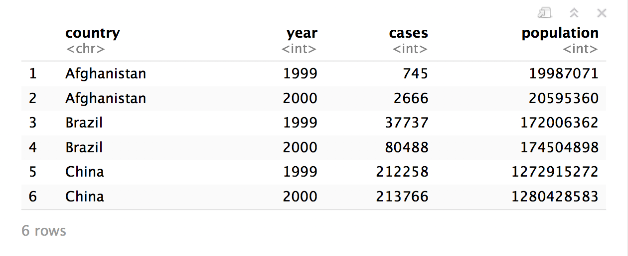
table2 %>%
pivot_wider(names_from = type, values_from = count)

Slide 72
who
(Untidy Data)

Slide 73
who
Tuberculosis (TB) cases broken down by year, country, age, gender, and diagnosis method from the 2014 World Health Organization Global Tuberculosis Report
View(who)

Slide 74
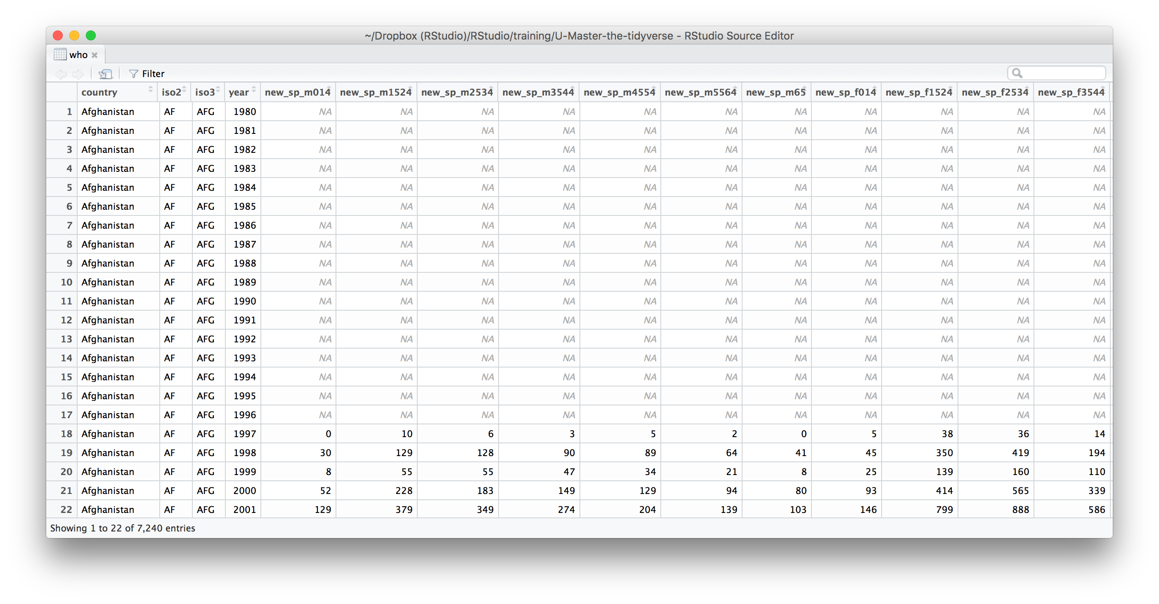
What variables does this data set contain?

Slide 75
who variables
country, iso2, iso3 - country identifiers
year - year
other columns names - encode type of TB case, sex, and age

Slide 76
who codes
Type of TB case
rel - relapse
ep - extra-pulmonary
sn- pulmonary, smear negative
sp -pulmonary, smear positive
Gender
m - male
f - female
Age group
014 - 0 to 14 years old
1524 - 15 to 24 years old
2534 - 25 to 34 years old
3544 - 35 to 44 years old
4554 - 45 to 54 years old
5564 - 55 to 64 years old
65 - 65 and older

Slide 78
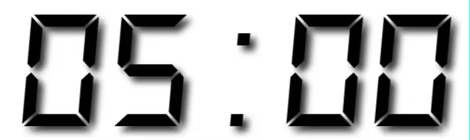
Your Turn 5
Gather the 5th through 60th columns of who into a pair of key:value columns named codes and n.
Then select just the county, year, codes and n variables.

Slide 79
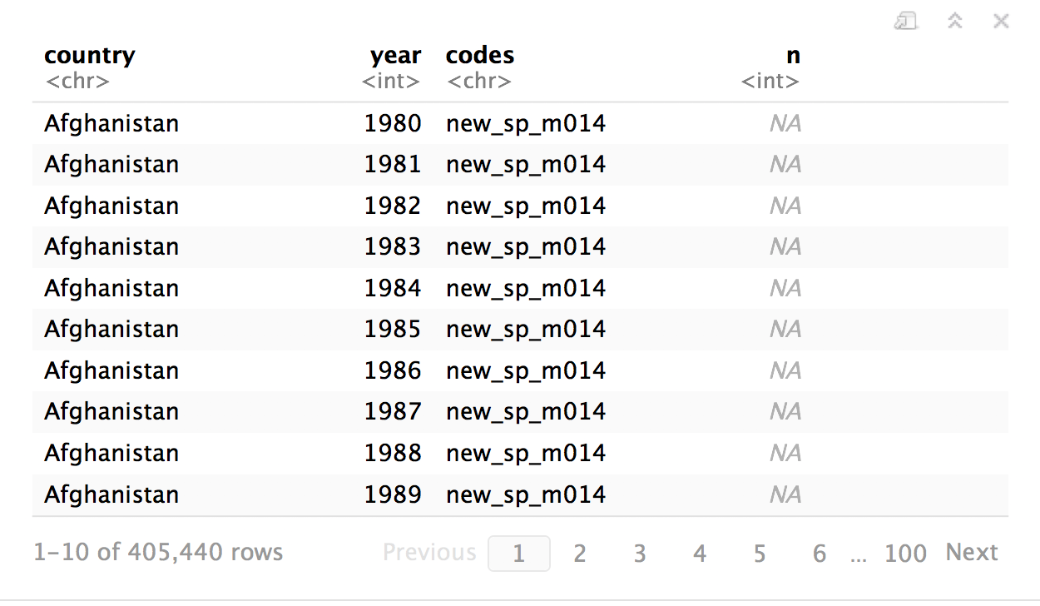
who %>%
gather("codes", "n", 5:60) %>%
select(-iso2, -iso3)

Slide 80
separate()

Slide 81
separate()
Splits a column by dividing values at a specific character.
who %>%
gather("codes", "n", 5:60) %>%
select(-iso2, -iso3) %>%
separate(codes, into = c("new", "type", "sexage"), sep = "_")
a column to split
names of new columns to make
string to split on
(Defaults to any non_alpha-numeric character)

Slide 82
separate(storms, date, c("year","month","day"), sep = "-")
storm wind pressure date
1 Alberto 110 1007 2000-08-03
2 Alex 45 1009 1998-07-27
3 Allison 65 1005 1995-06-03
4 Ana 40 1013 1997-06-30
5 Arlene 50 1010 1999-06-11
6 Arthur 45 1010 1996-06-17
storm wind pressure year month day
1 Alberto 110 1007 2000 08 03
2 Alex 45 1009 1998 07 27
3 Allison 65 1005 1995 06 03
4 Ana 40 1013 1997 06 30
5 Arlene 50 1010 1999 06 11
6 Arthur 45 1010 1996 06 17

Slide 83
separate(storms, date, c("year","month","day"), sep = "-")
storm wind pressure date
1 Alberto 110 1007 2000-08-03
2 Alex 45 1009 1998-07-27
3 Allison 65 1005 1995-06-03
4 Ana 40 1013 1997-06-30
5 Arlene 50 1010 1999-06-11
6 Arthur 45 1010 1996-06-17
storm wind pressure year month day
1 Alberto 110 1007 "2000" "08" "03"
2 Alex 45 1009 "1998" "07" "27"
3 Allison 65 1005 "1995" "06" "03"
4 Ana 40 1013 "1997" "06" "30"
5 Arlene 50 1010 "1999" "06" "11"
6 Arthur 45 1010 "1996" "06" "17"

Slide 84
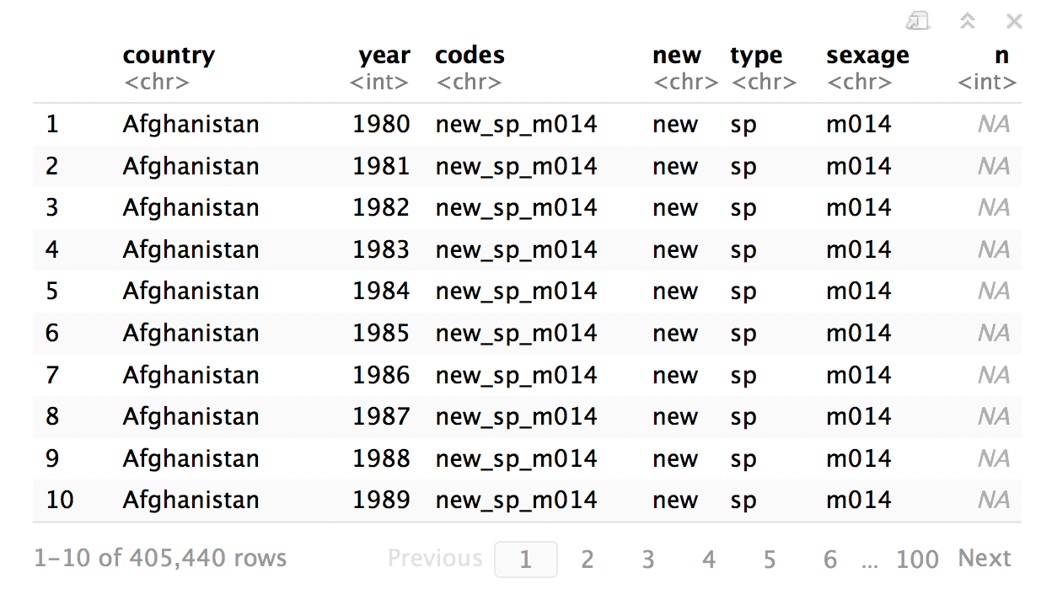
who %>%
gather("codes", "n", 5:60) %>%
select(-iso2, -iso3) %>%
separate(
)

Slide 85
who %>%
gather("codes", "n", 5:60) %>%
select(-iso2, -iso3) %>%
separate(codes
)

Slide 86
who %>%
gather("codes", "n", 5:60) %>%
select(-iso2, -iso3) %>%
separate(codes, into = c("new", "type", "sexage")
)

Slide 87
who %>%
gather("codes", "n", 5:60) %>%
select(-iso2, -iso3) %>%
separate(codes, into = c("new", "type", "sexage"), sep = "_")
)

Slide 88
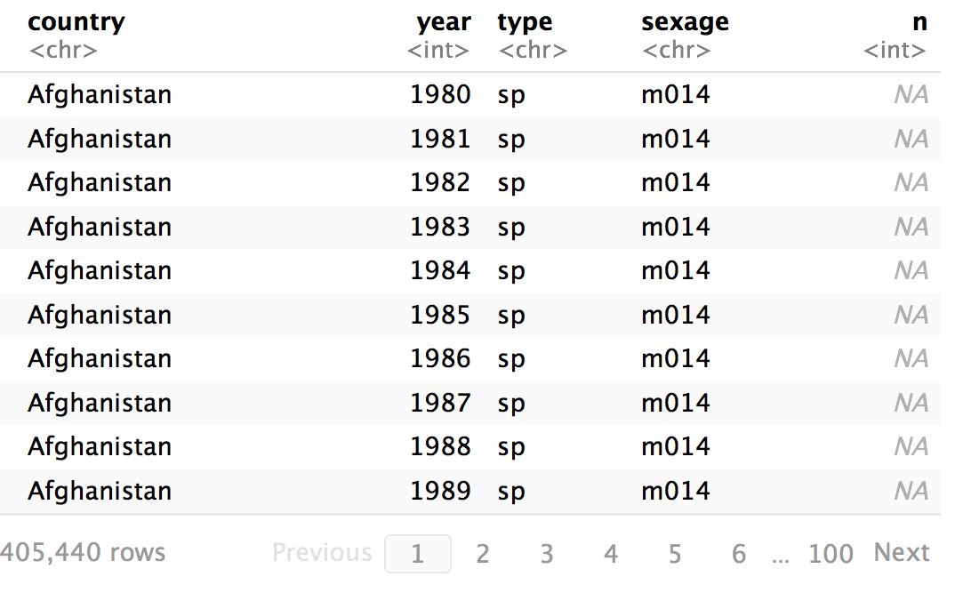
who %>%
gather("codes", "n", 5:60) %>%
select(-iso2, -iso3) %>%
separate(codes, c("new", "type", "sexage"), sep = "_") %>%
select(-new)

Slide 89
separate()
Splits a column by dividing values at a specific character.
who %>%
gather("codes", "n", 5:60) %>%
select(-iso2, -iso3) %>%
separate(codes, c("new", "type", "sexage"), sep = c(4, 7))
locations to split at
(Split after 4th and 7th characters)

Slide 90
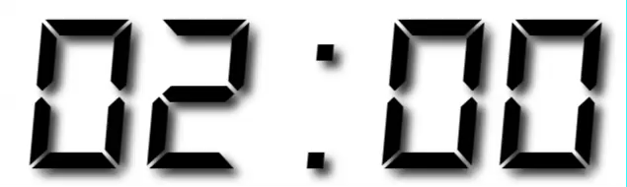
Your Turn 6
Separate the sexage column into sex and age columns.

Slide 91
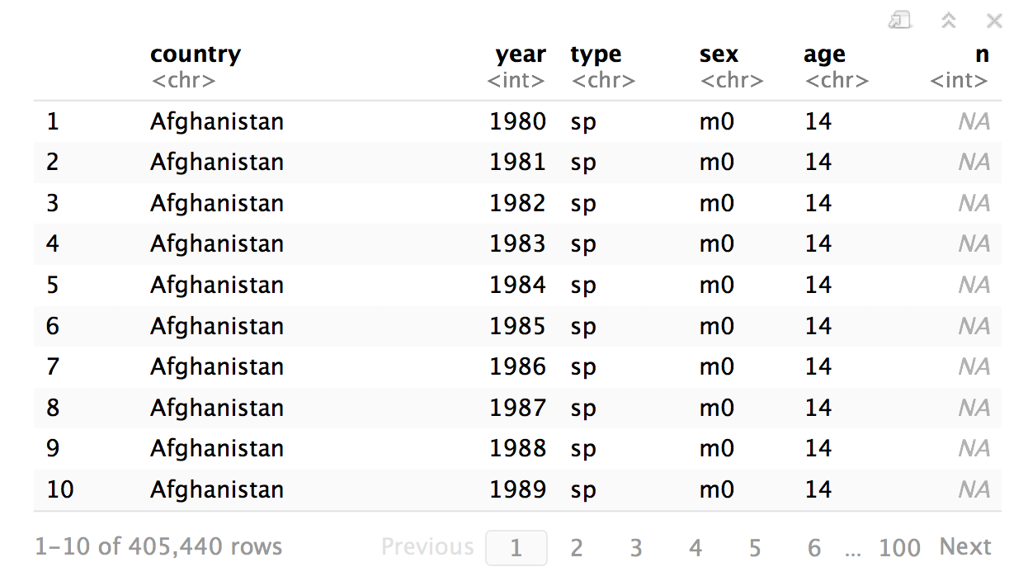
who %>%
gather("codes", "n", 5:60) %>%
select(-iso2, -iso3) %>%
separate(codes, c("new", "type", "sexage"), sep = "_") %>%
select(-new) %>%
separate(sexage, into = c("sex", "age"), sep = 1)

Slide 92
unite()

Slide 93
unite()
Unites columns into single column by combining cells.
unite(data, col, …, sep = "")
data frame to reshape
name of new column to make
(in quotes)
two or more columns to combine
separator to place between elements in new column
(Defaults to an underscore)

Slide 94
Missing
Values

Slide 95
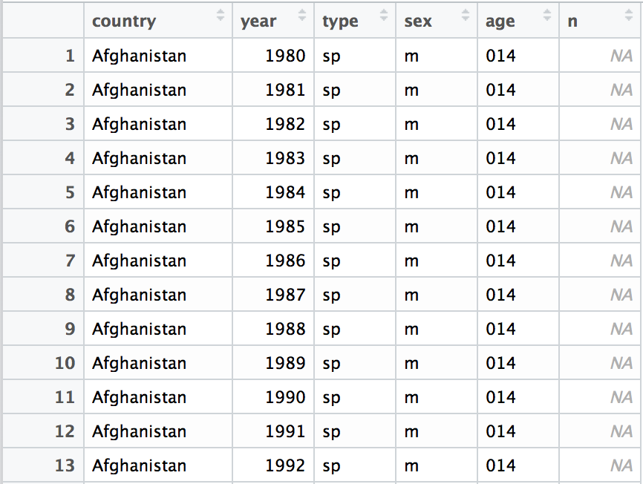
Can we clean up the missing values?

Slide 96
Toy data
x
x <- tribble(
~x1, ~x2,
"A", 1,
"B", NA,
"C", NA,
"D", 3,
"E", NA
)
x1 | x2
A | 1
B | NA
C | NA
D | 3
E | NA

Slide 97
fill()
Fills in NA’s with preceding (or following) values.
fill(x, x2, .direction = "down")
data frame to transform
column(s) with NA’s to replace
"down" fills each NA with the preceding value, "up" with the following value

Slide 98
fill()
Fills in NA’s with preceding (or following) values.
fill(x, x2, .direction = "down")
x
x
x1 | x2
A | 1
B | NA
C | NA
D | 3
E | NA
x1 | x2
A | 1
B | 1
C | 1
D | 3
E | 3

Slide 99
fill()
Fills in NA’s with preceding (or following) values.
fill(x, x2, .direction = "up")
x
x
x1 | x2
A | 1
B | NA
C | NA
D | 3
E | NA
x1 | x2
A | 1
B | 3
C | 3
D | 3
E | NA

Slide 100
replace_na()
Replace NA’s by column.
replace_na(x, replace = list(x2 = 2))
data frame to transform
A named list of column names paired with values to replace NA’s with.

Slide 101
replace_na()
Replace NA’s by column.
replace_na(x, replace = list(x2 = 2))
x
x
x1 | x2
A | 1
B | NA
C | NA
D | 3
E | NA
x1 | x2
A | 1
B | 2
C | 2
D | 3
E | 2

Slide 102
drop_na()
Drops rows that contain NA’s in the specified columns.
drop_na(x, x2)
data frame to transform
column(s) to screen for NA’s

Slide 103
drop_na()
Drops rows that contain NA’s in the specified columns.
drop_na(x, x2)
x
x
x1 | x2
A | 1
B | NA
C | NA
D | 3
E | NA
x1 | x2
A | 1
D | 3

Slide 104
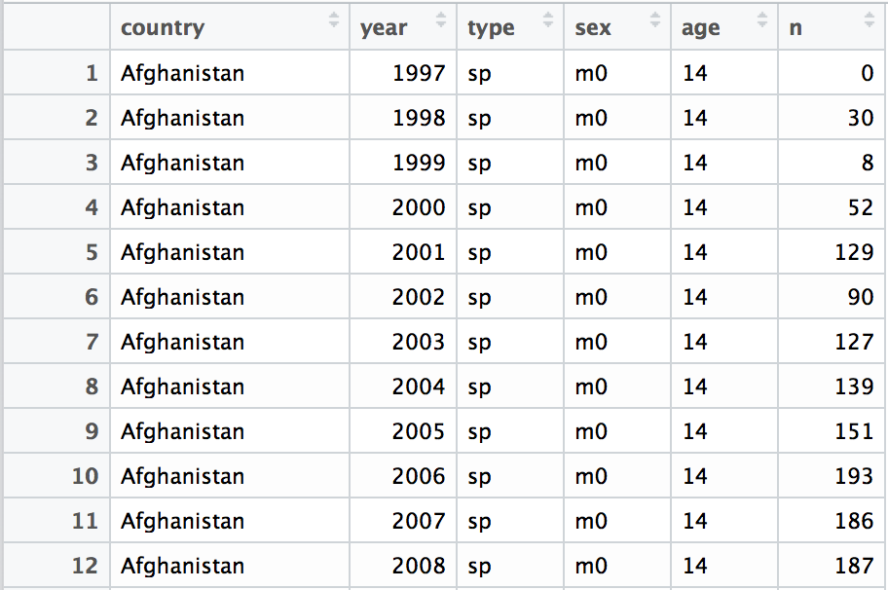
who %>%
gather("codes", "n", 5:60) %>%
separate(codes, c("new", "type", "sexage"), sep = "_") %>%
select(-new, -iso2, -iso3) %>%
separate(sexage, c("sex", "age"), sep = 2) %>%
drop_na(n)

Slide 105
Recap
 | wind | wind
 | pressure | 1009
 | pressure | 1009
 | Allison | 1005
 | Allison | 1013
 | Arlene | 1010
 | Arthur | 1010
 | pressure
 | 1007
 | 1009
Move values into column names with spread()
 | pressure
 | 1007
 | 1009
 | wind | wind
 | pressure | 1009
 | pressure | 1009
 | Allison | 1005
 | Allison | 1013
 | Arlene | 1010
 | Arthur | 1010
Move column names into values with gather()
Split a column with separate() or separate_rows()
wind
1005
1005
1005
1005
1005
1005
wind
1005
1005
1005
1005
1005
1005
wind
1005
1005
1005
1005
1005
1005
wind
1005
1005
1005
1005
1005
1005
wind
1005
1005
1005
1005
1005
1005
wind
1005
1005
1005
1005
1005
1005
wind
1005
1005
1005
1005
1005
1005
wind
1005
1005
1005
1005
1005
1005
Unite columns with unite()

Slide 107
Reshaping
Final Exam

Slide 108
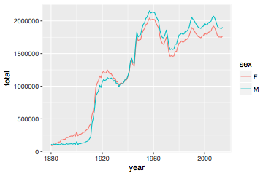
Number of children by year and gender
CC BY-SA RStudio

Slide 109
Can we calculate the ratio of boys to girls?
babynames %>%
group_by(year, sex) %>%
summarise(n = sum(n))
year sex n
<dbl> <chr> <int>
1 1880 F 90993
2 1880 M 110491
3 1881 F 91954
4 1881 M 100745
5 1882 F 107850
6 1882 M 113688
7 1883 F 112321
8 1883 M 104629
9 1884 F 129022
10 1884 M 114445
# ... with 260 more rows
CC BY-SA RStudio

Slide 110
Can we calculate the ratio of boys to girls?
babynames %>%
group_by(year, sex) %>%
summarise(n = sum(n))
year sex n
<dbl> <chr> <int>
1 1880 F 90993
2 1880 M 110491
3 1881 F 91954
4 1881 M 100745
5 1882 F 107850
6 1882 M 113688
7 1883 F 112321
8 1883 M 104629
9 1884 F 129022
10 1884 M 114445
# ... with 260 more rows
Now what?
CC BY-SA RStudio

Slide 111
Can we calculate the ratio of boys to girls?
better_layout %>%
mutate(percent_male = M / (M + F) * 100)
year sex n
<dbl> <chr> <int>
1 1880 F 90993
2 1880 M 110491
3 1881 F 91954
4 1881 M 100745
5 1882 F 107850
6 1882 M 113688
7 1883 F 112321
8 1883 M 104629
9 1884 F 129022
10 1884 M 114445
# ... with 260 more rows
year F M
* <dbl> <int> <int>
1 1880 90993 110491
2 1881 91954 100745
3 1882 107850 113688
4 1883 112321 104629
5 1884 129022 114445
6 1885 133055 107800
7 1886 144535 110784
8 1887 145982 101414
9 1888 178627 120853
10 1889 178366 110584
?
CC BY-SA RStudio

Slide 112
Your Turn 7
Reshape the layout of this data. Calculate the percent of male (or female) children by year. Then plot the percent over time.
babynames %>%
group_by(year, sex) %>%
summarise(n = sum(n))

Slide 113
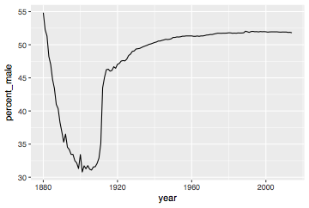
babynames %>%
group_by(year, sex) %>%
summarise(n = sum(n)) %>%
spread(sex, n) %>%
mutate(percent_male = M / (M + F) * 100) %>%
ggplot(aes(year, percent_male)) + geom_line()
CC BY-SA RStudio

Slide 114
Percent of children that are male by year
CC BY-SA RStudio

Slide 115
General advice
Describe what you want to do in an equation. Each variable in the equation should correspond to a variable in your data:
"color by sex"
color = sex
"calculate the proportion of males"
prop male = number of males / number of females + number of males

Slide 116
Section

Slide 117
Code
HTTP Verb
HTTP version
URL path
URL path
GET /resources/webinars/ HTTP/1.1
Host: www.rstudio.com
User-Agent: libcurl/7.43.0 r-curl/2.1 httr/1.2.1
Accept-Encoding: gzip, deflate
Accept: application/json, text/xml, application/xml, */*
CC BY-SA RStudio

Slide 118
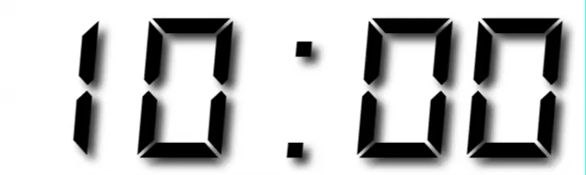
Your Turn
Open R. Then download the packages that we will use today by running the following code.

Slide 119
Sub section

Slide 120
CC BY-SA RStudio

Slide 121









Technical Diagram
Shiny Server Pro
Production
Data Scientists
RStudio IDE
End Users
Web Browsers
Sticky Load Balancer
Staging
Data Stores
File Share
Data Mart

Slide 122





















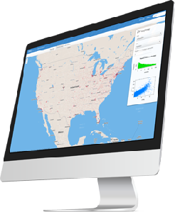
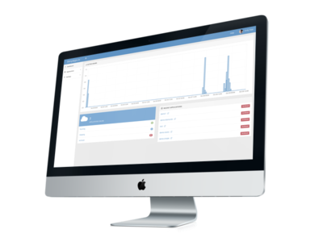



















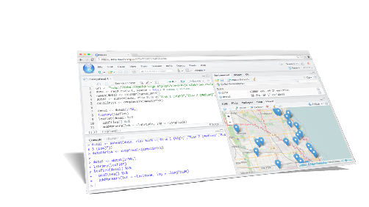
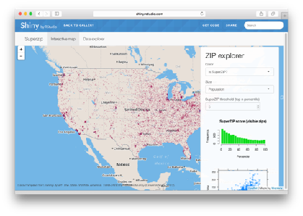






Icons
Hardware
Software
Packages
Architecture
dplyr
0.4
+
SYSTEM LIBRARY

Slide 123


Hardware
Software
Packages
Architecture

rvest

